Slide 1
Optimizing Matrix Multiplication for CPU efficiency.

Slide 2
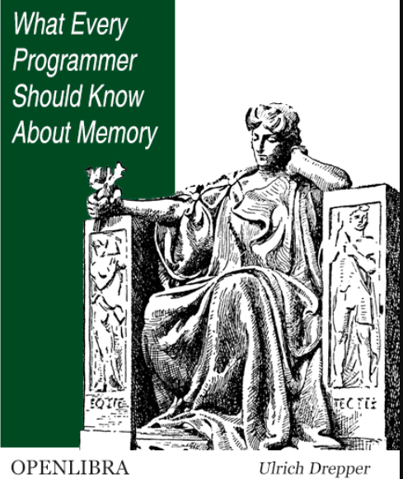
.

Slide 3
Outline
Matrix multiplication
Principle of locality
Extended instruction sets
Loop unrolling optimization
Multithreading optimization
Benchmarks
Summary

Slide 4
Outline
Matrix multiplication
Principle of locality
Extended instruction sets
Loop unrolling optimization
Multithreading optimization
Benchmarks
Summary

Slide 5
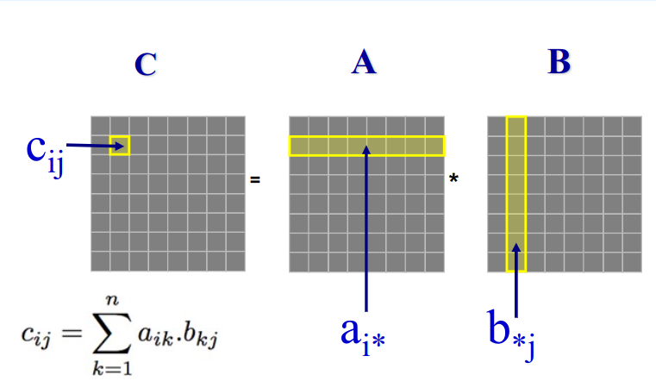
Matrix multiplication

Slide 6
CPU overview

Slide 7
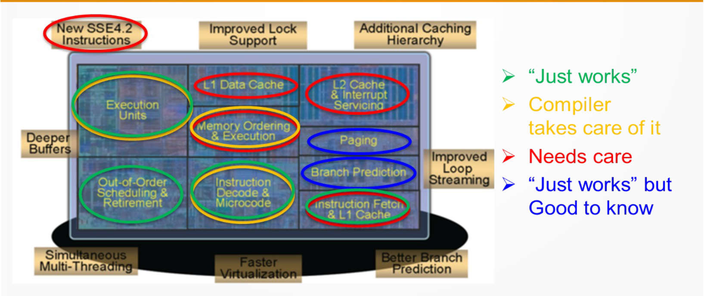
CPU overview

Slide 8
CPU overview
Focus on these

Slide 9
Outline
Matrix multiplication
Principle of locality
Extended instruction sets
Loop unrolling optimization
Multithreading optimization
Benchmarks
Summary

Slide 10
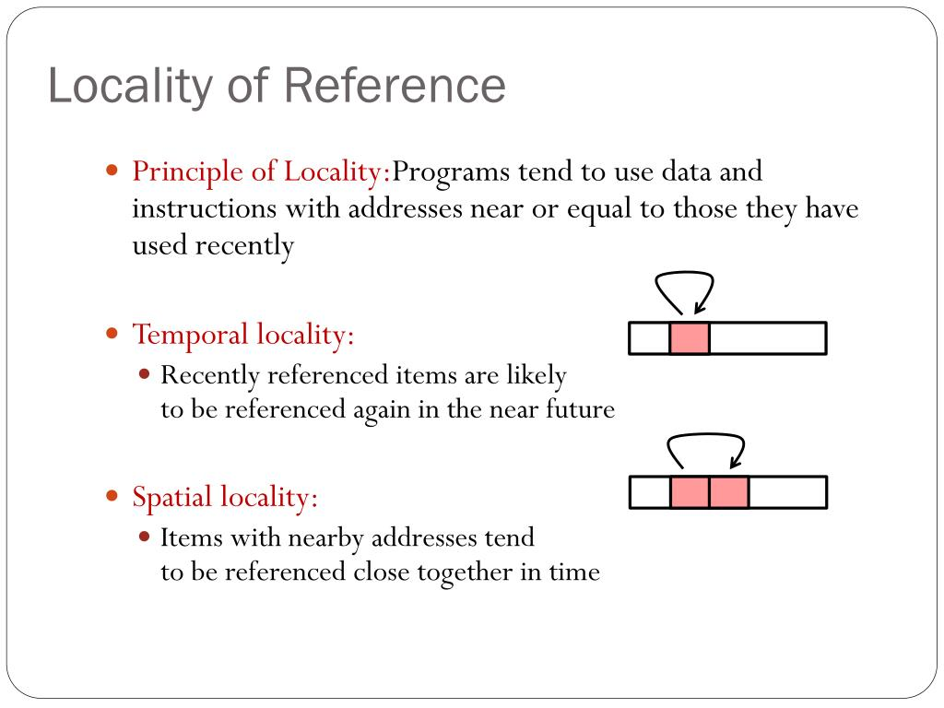
Principle of locality

Slide 11
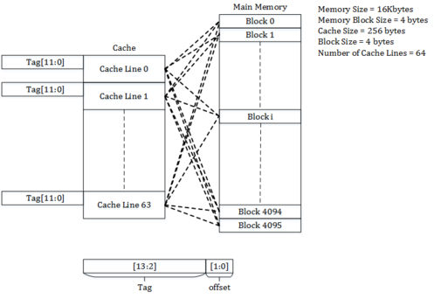
Principle of locality

Slide 12
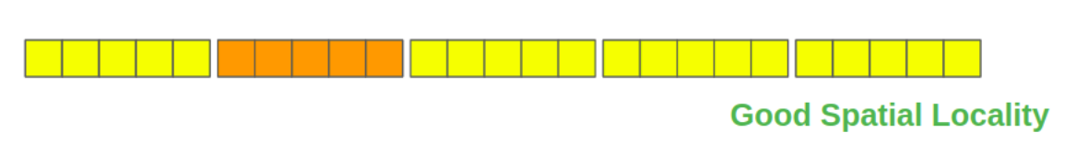
Spatial locality
std::vector
cache line

Slide 13
Spatial locality
std::list
Cache line
Bad Spatial Locality
Cache miss = Load from slow memory

Slide 14
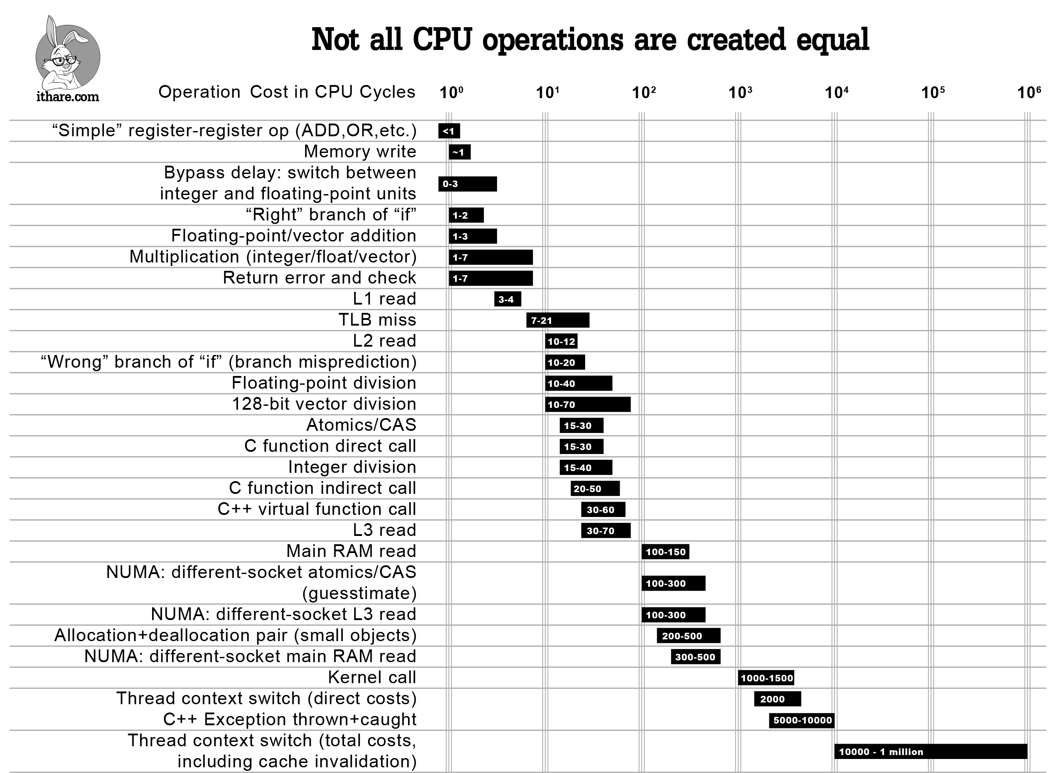
Operation cost

Slide 15
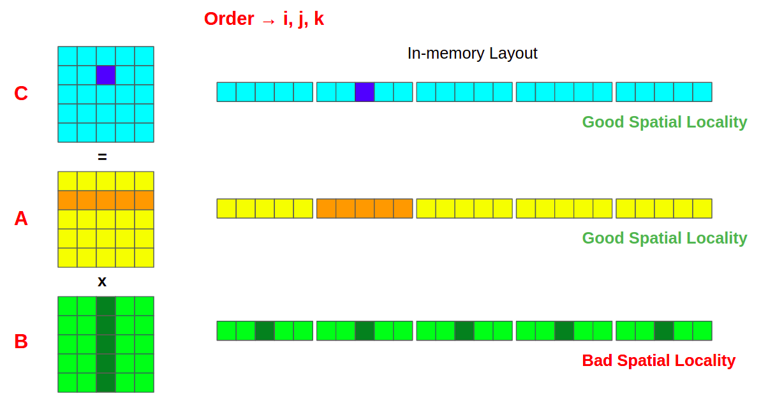
Spatial locality

Slide 16
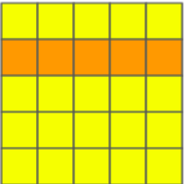
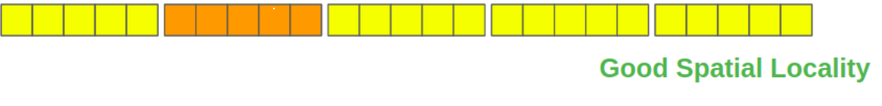
Spatial locality
T

Slide 17
Temporal locality
r₁₁ = a₁₁*b₁₁ + a₁₂*b₂₁ + a₁₃*b₃₁ + …
r₁₂ = a₁₁*b₁₂ + a₁₂*b₂₂ + a₁₃*b₃₂ + …
r₁₃ = a₁₁*b₁₃ + a₁₂*b₂₃ + a₁₃*b₃₃ + …

Slide 18
Temporal locality
r₁₁ = a₁₁*b₁₁ + a₁₂*b₂₁ + a₁₃*b₃₁
r₁₂ = a₁₁*b₁₂ + a₁₂*b₂₂ + a₁₃*b₃₂
r₁₃ = a₁₁*b₁₃ + a₁₂*b₂₃ + a₁₃*b₃₃
a₁₁ | a₁₂ | a₁₃
Cache lines
b₁₁ | b₁₂ | b₁₃
b₂₁ | b₂₂ | b₂₃
b₃₁ | b₃₂ | b₃₃

Slide 19
Block matrix multiplication
x
=
A
B
C

Slide 20
Block matrix multiplication
x
=
A
B
C

Slide 21
Block matrix multiplication
x
=
A
B
C

Slide 22
Block matrix multiplication
x
=
A
B
C

Slide 23
Block matrix multiplication
x
=
A
B
C

Slide 24
Block matrix multiplication
x
=
A
B
C

Slide 25
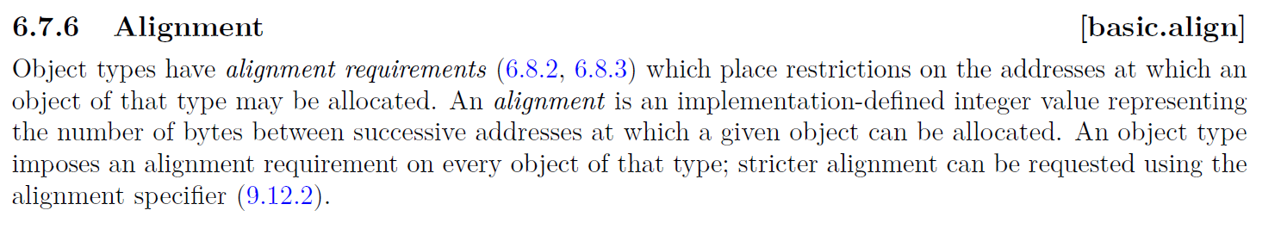
Alignment

Slide 26
Alignment
Cache line
Aligned
0 | 1 | 2 | 3 | 4 | 5
Unaligned
xxx | xxx | 0 | 1 | 2 | 3
Memory | 0x0000 | 0x0004 | 0x0008 | 0x000C | 0x0010 | 0x0014

Slide 27
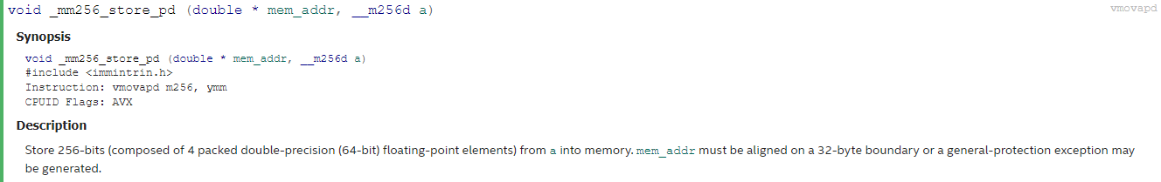
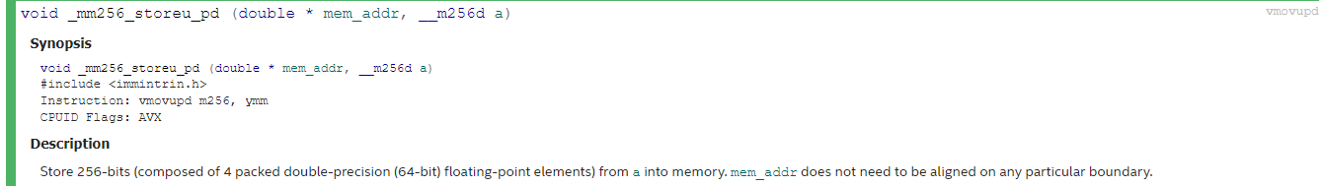
Alignment

Slide 28
Outline
Matrix multiplication
Principle of locality
Extended instruction sets
Loop unrolling optimization
Multithreading optimization
Benchmarks
Summary

Slide 29
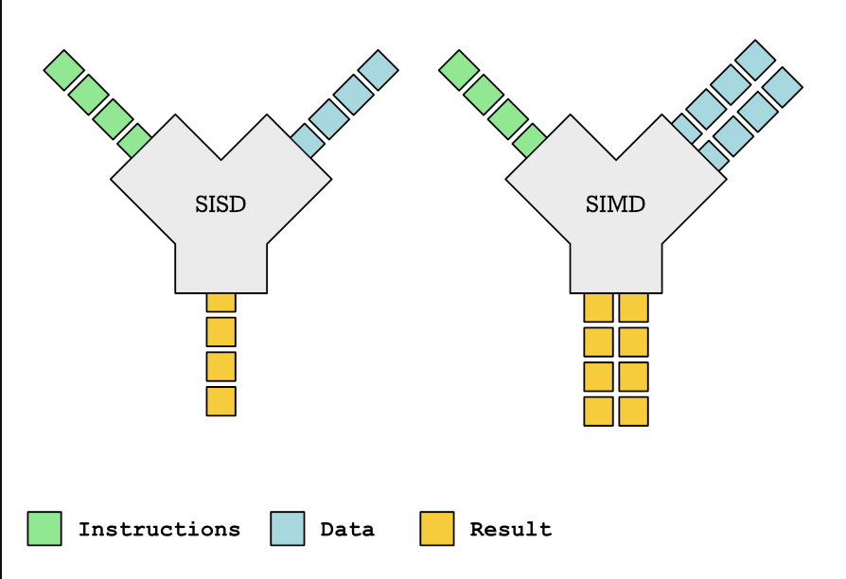
Extended instruction set
SISD - Single Instruction/Single Data
SIMD - Single Instruction/Multiple Data

Slide 30
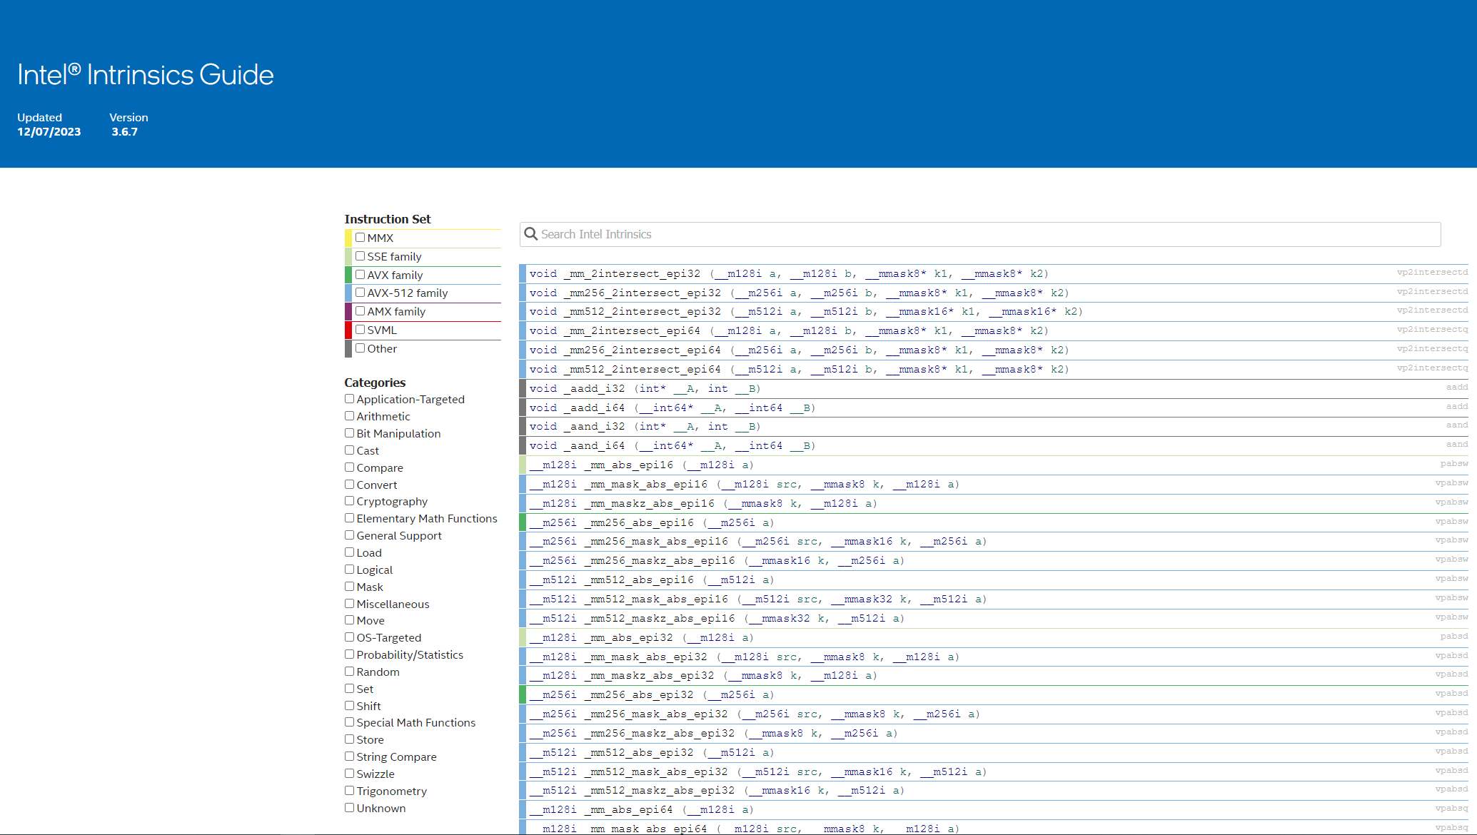
Extended instruction set

Slide 31
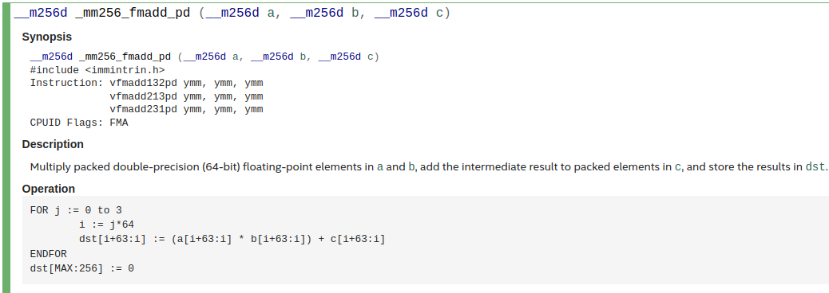
Extended instruction set

Slide 32
Extended instruction set
r₁₁ = a₁₁*b₁₁ + a₁₂*b₂₁ + a₁₃*b₃₁
r₁₂ = a₁₁*b₁₂ + a₁₂*b₂₂ + a₁₃*b₃₂
r₁₃ = a₁₁*b₁₃ + a₁₂*b₂₃ + a₁₃*b₃₃
a₁₁ | a₁₂ | a₁₃
Cache lines
b₁₁ | b₁₂ | b₁₃
b₂₁ | b₂₂ | b₂₃
b₃₁ | b₃₂ | b₃₃

Slide 33
Extended instruction set
r₁₁ = a₁₁*b₁₁ + a₁₂*b₂₁ + a₁₃*b₃₁
r₁₂ = a₁₁*b₁₂ + a₁₂*b₂₂ + a₁₃*b₃₂
r₁₃ = a₁₁*b₁₃ + a₁₂*b₂₃ + a₁₃*b₃₃
a₁₁ | a₁₂ | a₁₃
Cache lines
b₁₁ | b₁₂ | b₁₃
b₂₁ | b₂₂ | b₂₃
b₃₁ | b₃₂ | b₃₃

Slide 34
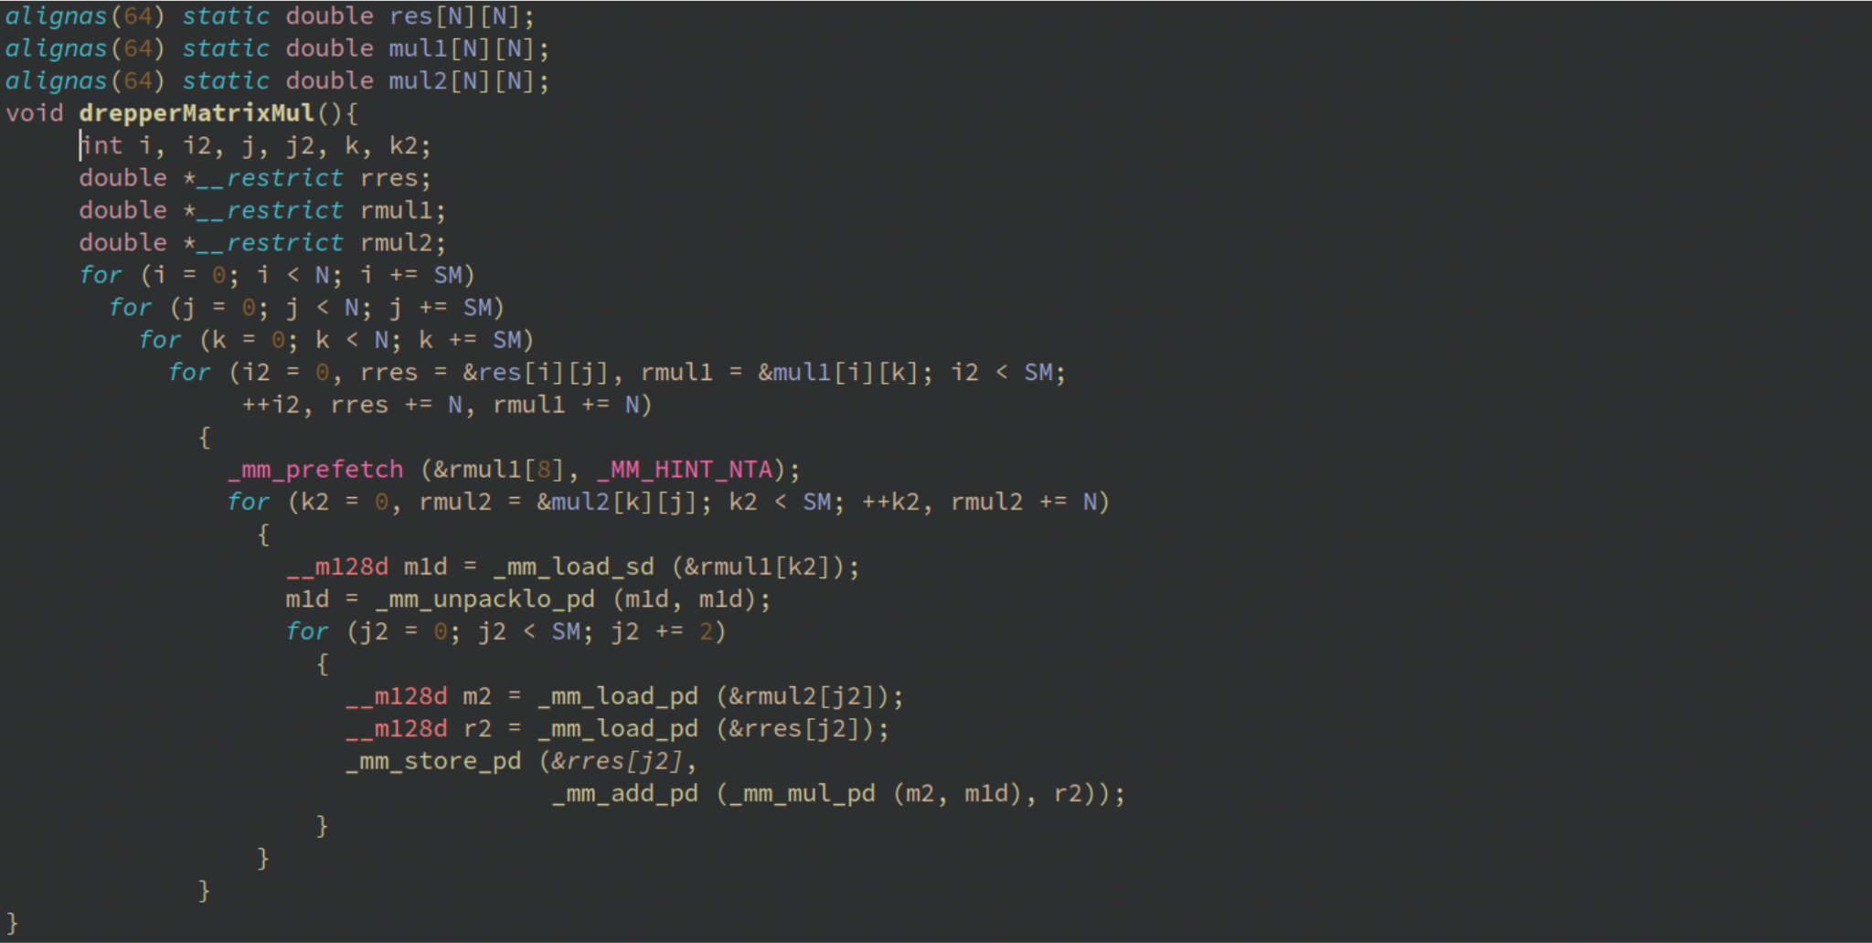
Ulrich’s code

Slide 35
Alignment

Slide 36
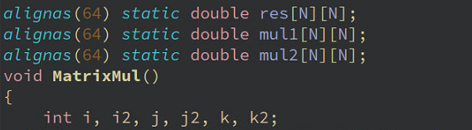
Code

Slide 37
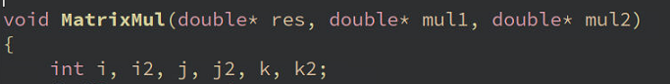
Code

Slide 38
Code
Slow down

Slide 39
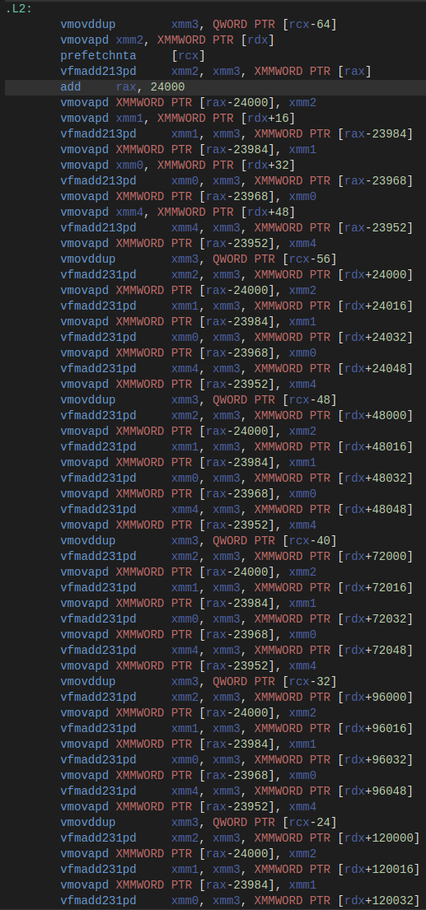
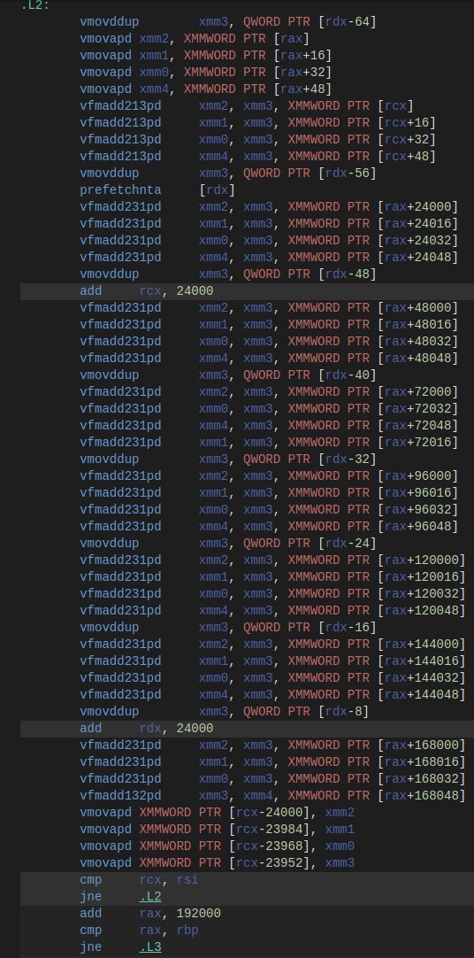
double*
double[][]

Slide 40
Every iteration write to result matrix
Write to result matrix when block is calculated

Slide 41
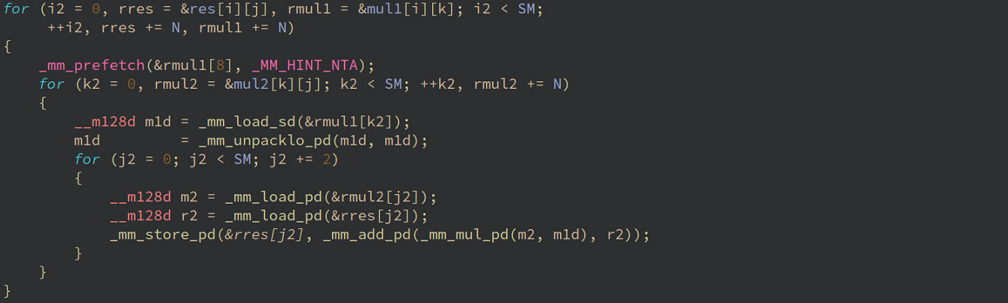
Loop unrolling
Unroll

Slide 42
Loop unrolling optimization
Can’t optimize write to res matrix

Slide 43
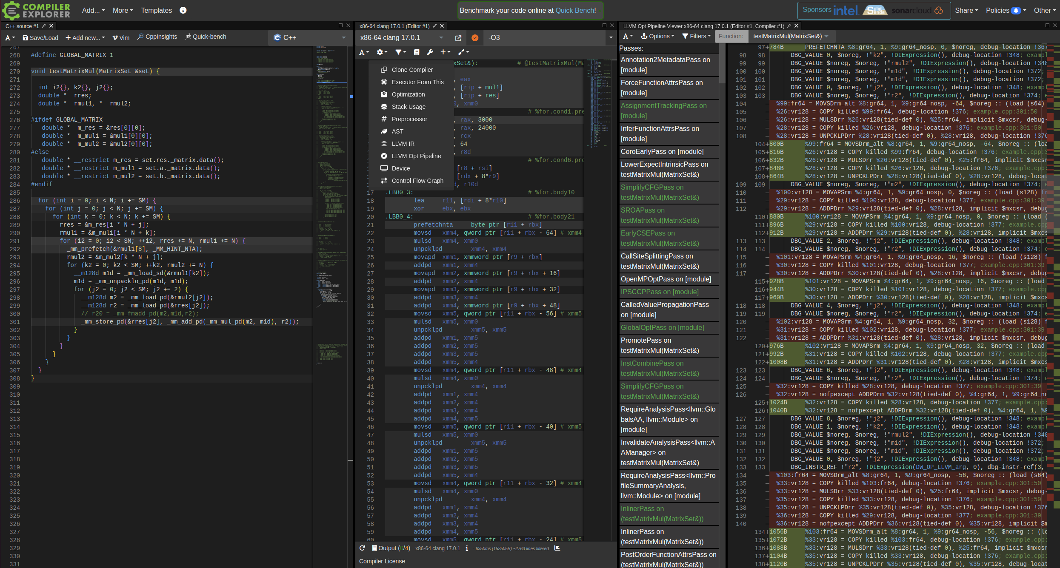
Compiler explorer

Slide 44
Outline
Matrix multiplication
Principle of locality
Extended instruction sets
Loop unrolling optimization
Multithreading optimization
Benchmarks
Summary

Slide 45
Loop unrolling optimization
Unroll manually

Slide 46
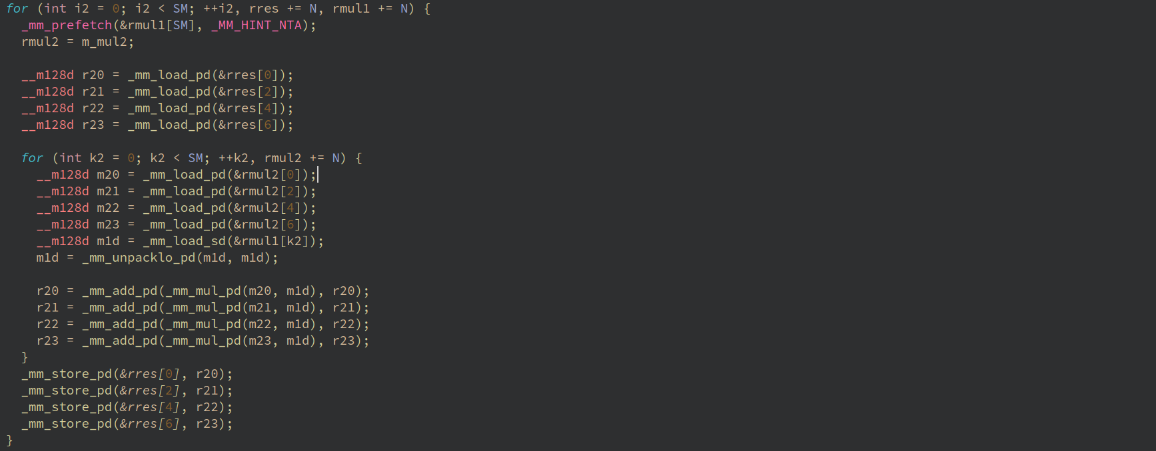
Loop unrolling optimization

Slide 47
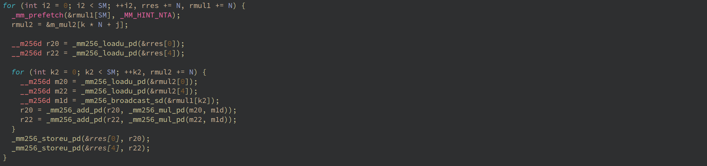
Loop unrolling optimization

Slide 48
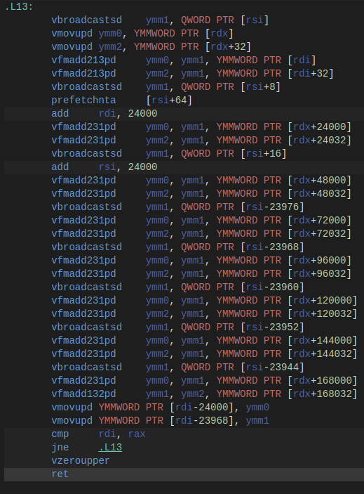
Loop unrolling optimization

Slide 49
Outline
Matrix multiplication
Principle of locality
Extended instruction sets
Loop unrolling optimization
Multithreading optimization
Benchmarks
Summary

Slide 50
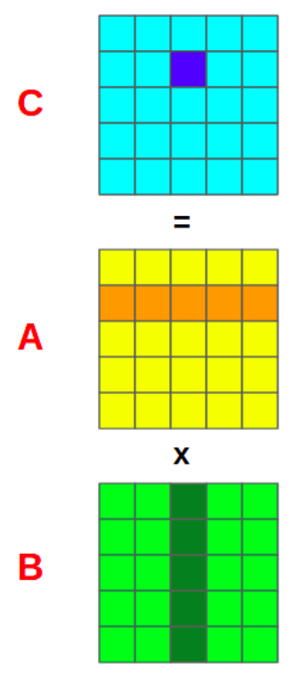
Multi-threading optimization
Thread 1
Thread N
Divide-and-conquer algorithm
Thread 1
Thread N
Thread 1
Thread N

Slide 51
Outline
Matrix multiplication
Principle of locality
Extended instruction sets
Loop unrolling optimization
Multithreading optimization
Benchmarks
Summary

Slide 52
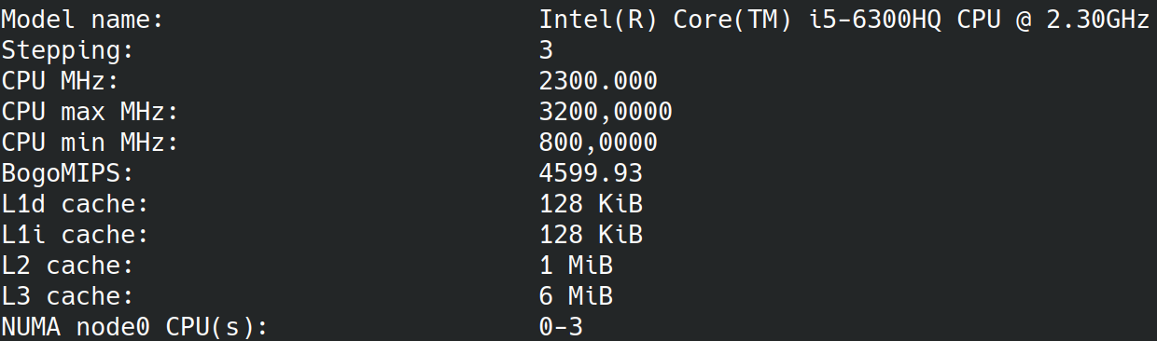
Benchmarks

Slide 53
Benchmarks
Google benchmark https://github.com/google/benchmark
Compiler flags: -O3 -march=native
OpenBLAS is an open-source implementation of the BLAS (Basic Linear Algebra Subprograms) and LAPACK APIs with many hand-crafted optimizations for specific processor types

Slide 54
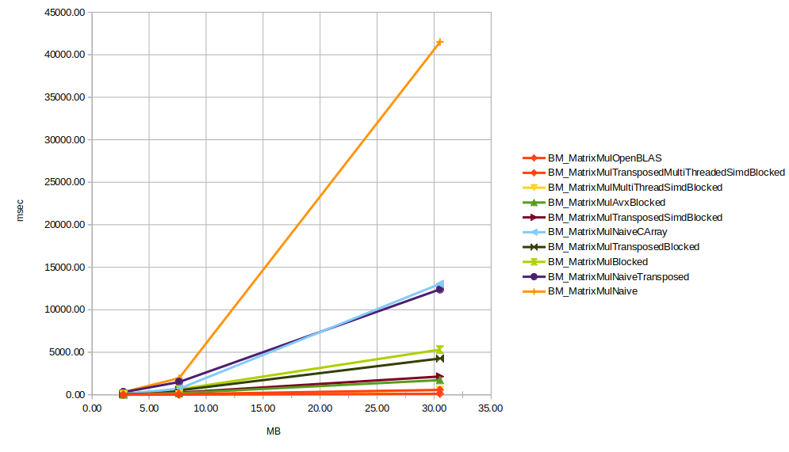
Benchmarks

Slide 55
Benchmarks
Best case vs worst case: 360x performance boost

Slide 56
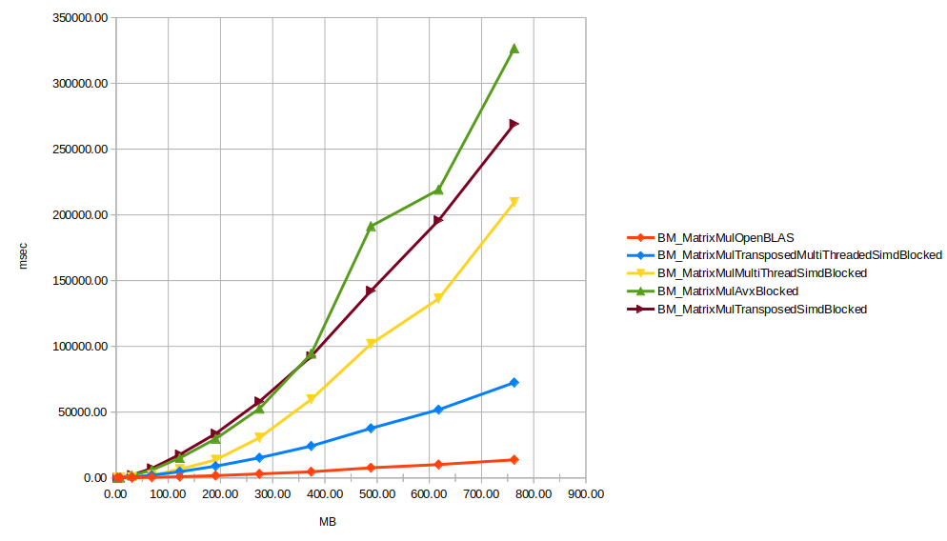
Benchmarks

Slide 57
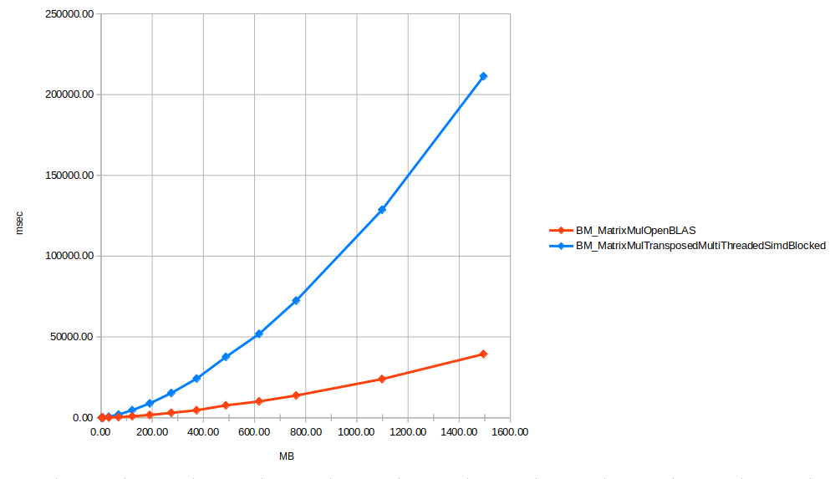
Benchmarks

Slide 58
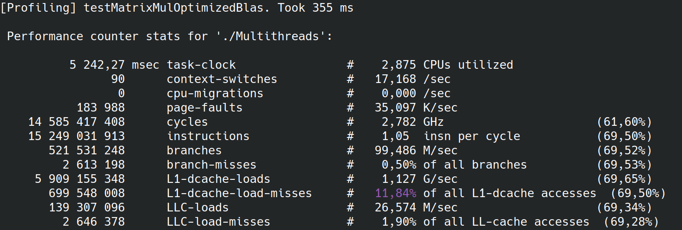
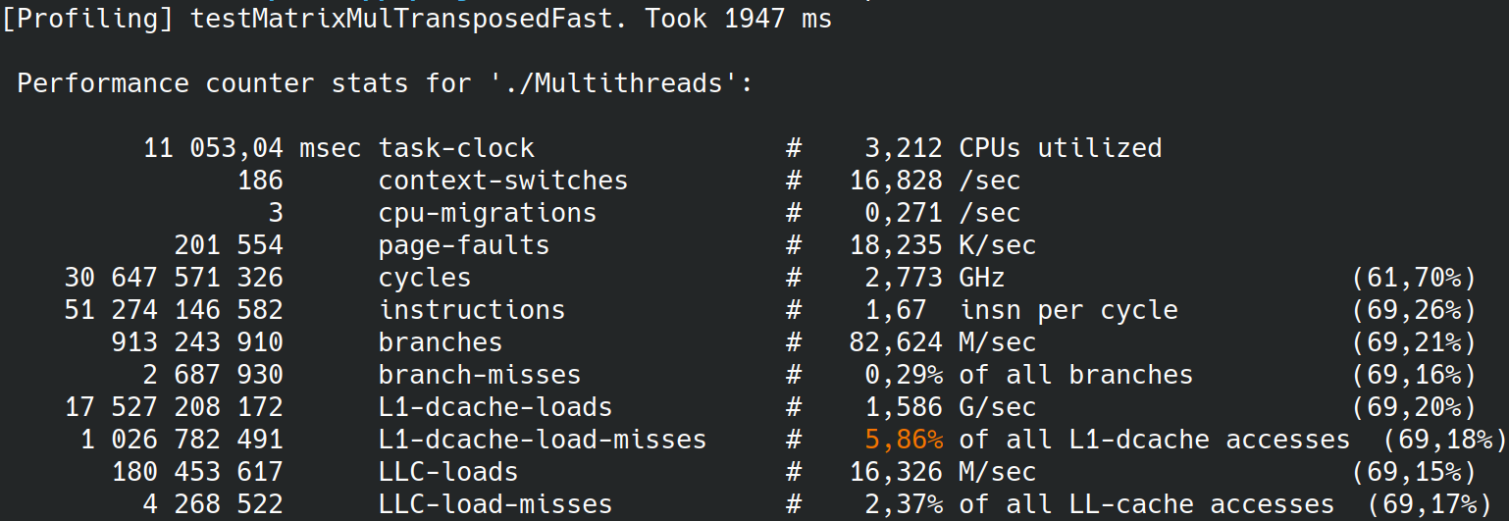
Benchmarks

Slide 59
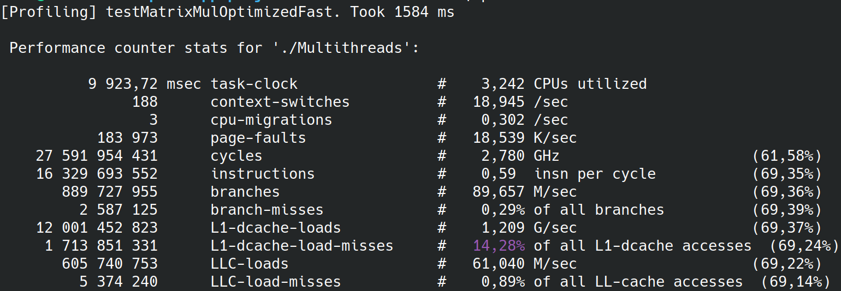
Benchmarks

Slide 60
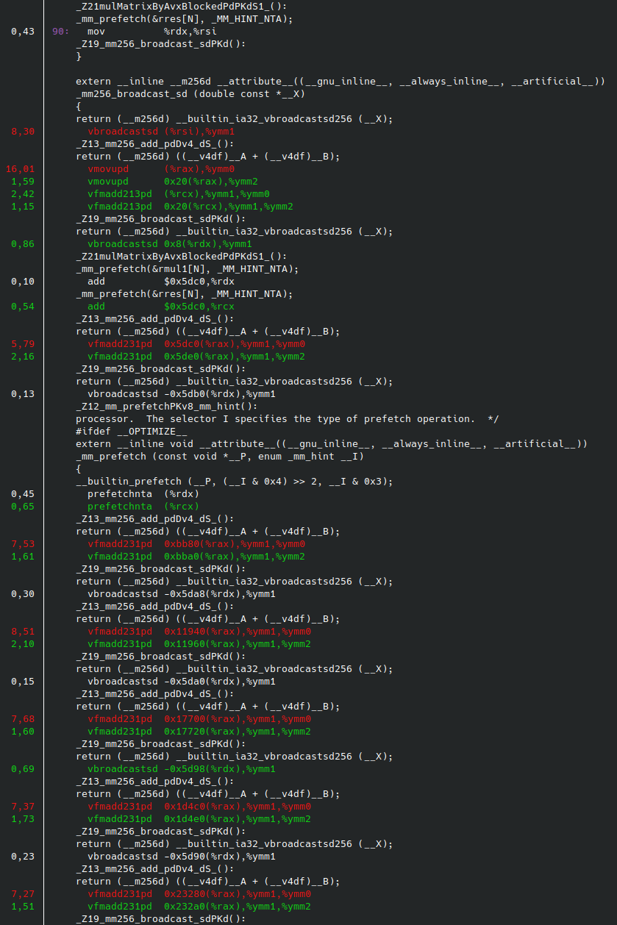
Benchmarks

Slide 61
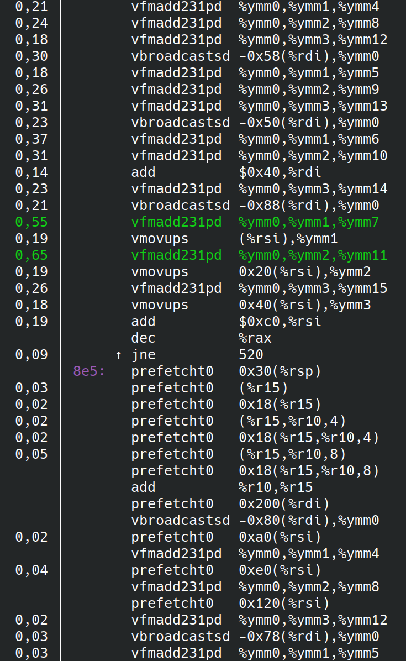
Benchmarks
5000 lines of assembly code https://github.com/OpenMathLib/OpenBLAS/blob/develop/kernel/x86_64/dgemm_kernel_4x8_haswell.S
1. Small data offsets
2. Heavily usage of prefetcht commands

Slide 62
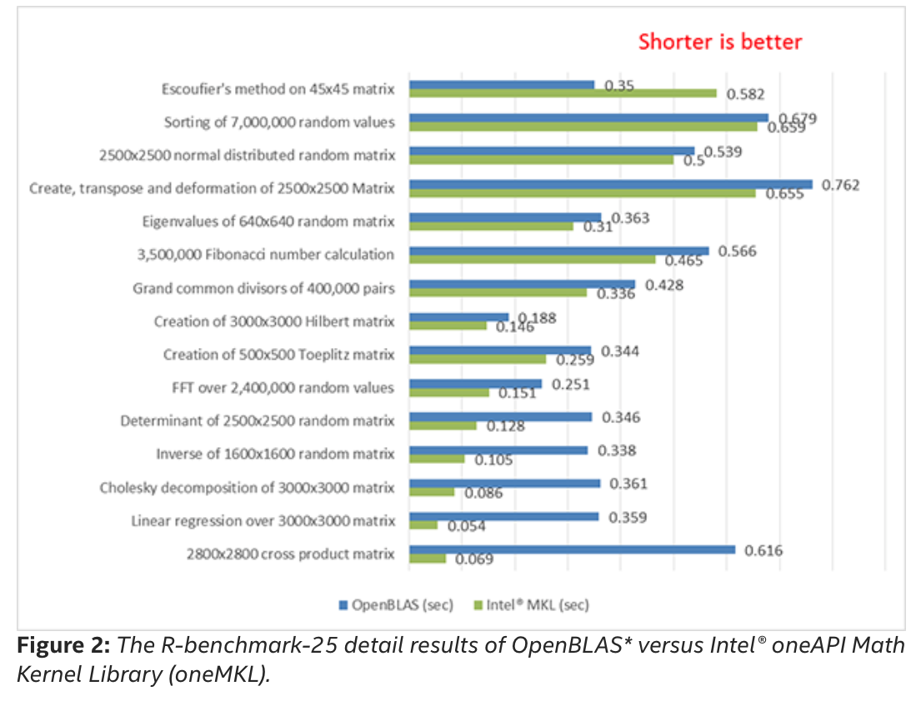
Benchmarks

Slide 63
Outline
Matrix multiplication
Principle of locality
Extended instruction sets
Loop unrolling optimization
Multithreading optimization
Benchmarks
Summary

Slide 64
Summary
Design: data-oriented design, branchless code, value semantic
C++ : Alignment, containers, keywords(const, restrict)
Linker: ALSR, LTO
Compiler: flags, extensions (intrinsic, prefetch,…), PGO
OS: thread affinity, page size configuration
Asm: Instruction set(simd)
CPU model: caches, MMU, pipeline, branch predictor
Tools: perf, benchmark
Algorithms and data structures (sparse matrix)
Hardware: We are not limited with CPU: GPU usage

Slide 65
Bibliography
What every programmer should know about memory - https://people.freebsd.org/~lstewart/articles/cpumemory.pdf
OpenBLAS - https://github.com/OpenMathLib/OpenBLAS
Multidimensional C++ - https://www.youtube.com/watch?v=aFCLmQEkPUw
ARM® Cortex® -A55 Core https://documentation-service.arm.com/static/5e7e1405b471823cb9de57ae?token=
Andrew S. Tanenbaum. Structured Computer Organization - https://csc-knu.github.io/sys-prog/books/Andrew%20S.%20Tanenbaum%20-%20Structured%20Computer%20Organization.pdf
Matt Godbolt. What's New in Compiler Explorer? https://www.youtube.com/watch?v=O5sEug_iaf4
A free function linear algebra interface based on the BLAS https://www.open-std.org/jtc1/sc22/wg21/docs/papers/2023/p1673r13.html
std::linalg: Linear Algebra Coming to Standard C++ - Mark Hoemmen - CppCon 2023

Slide 66
Thank you!

Slide 68
Summary
High performance application requires knowledge about whole system
C++ : Memory layout, alignment, SIMD(std::execution policies), threads
CPU: caches, MMU, pipeline, branch predictor, prefetch, multiple cores

Slide 69
Outline
CPU overview
Matrix multiplication
Principle of locality
Extended instruction sets
Loop unrolling optimization
Multithreading optimization
Benchmarks
Summary

Slide 70
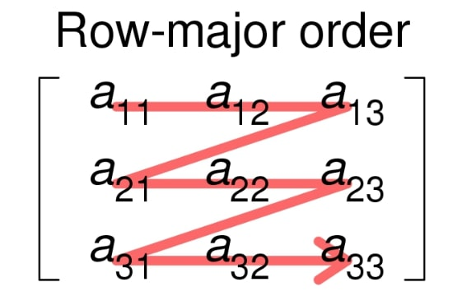
Matrix representation

Slide 71
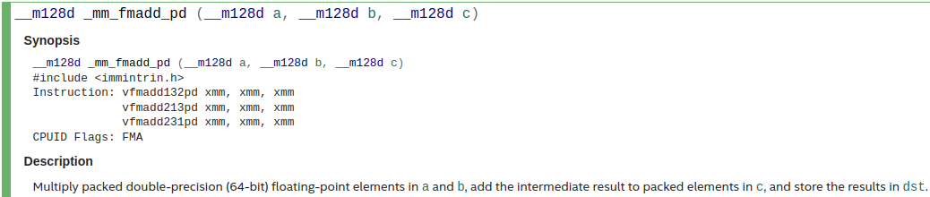
Extended instruction set

Slide 72
Cache
Cache line ( size )
Size
Levels (L1, L2, L3)
L1→virtual addresses, L2,L3 → physical addresses
Types : instruction, data, TLB
Ownership: Unique, shared. L2 cache is shared between cores.
Associativity

Slide 73
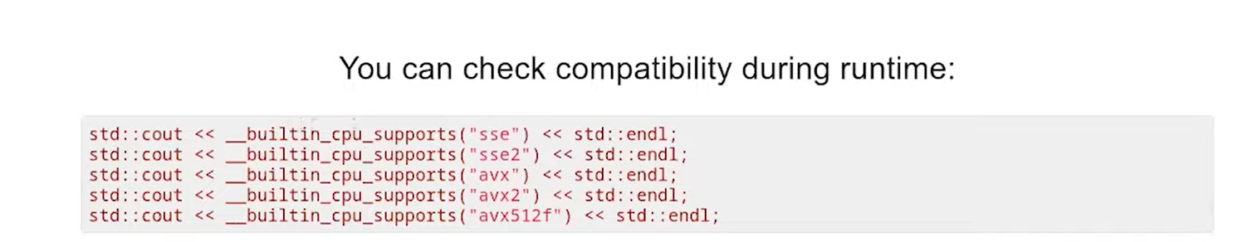
Extended instruction set

Slide 74
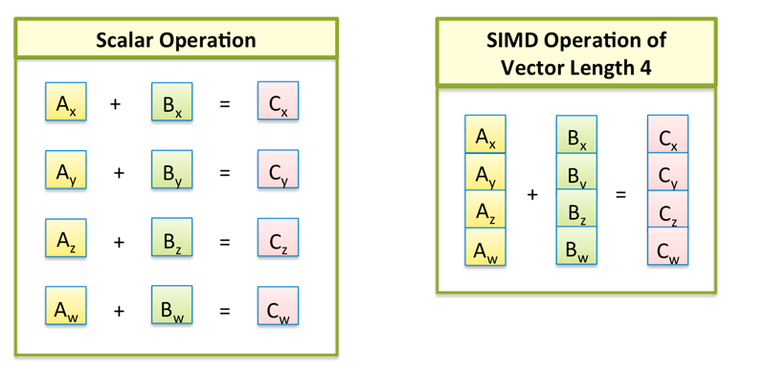
Extended instruction set
SIMD - Single Instruction/Multiple Data

Slide 75
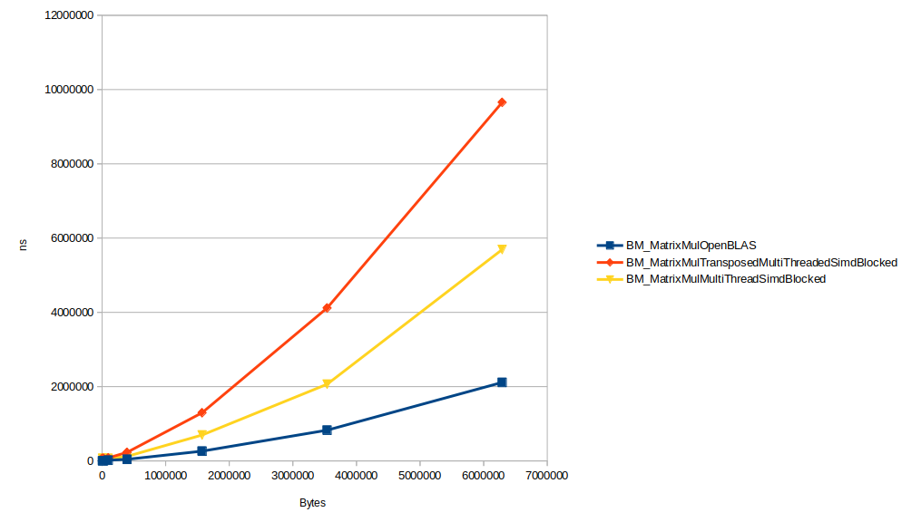
Benchmarks

Slide 76
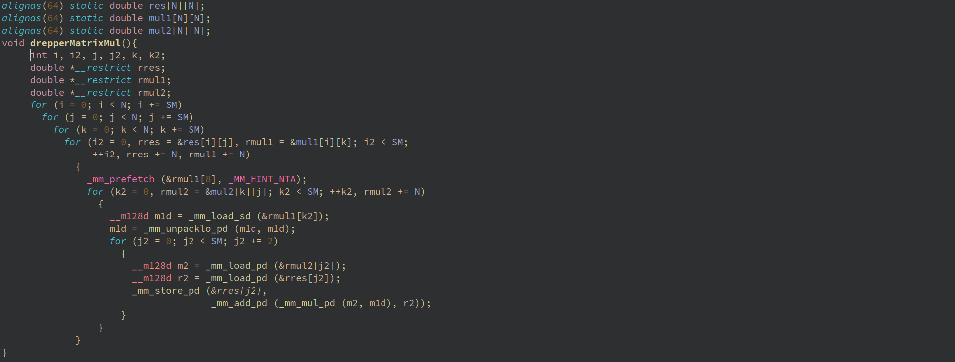
Ulrich’s code

Slide 77
Performance & efficiency
High performance recommendations:
Choosing the right algorithm
Using CPU resources effectively
Avoiding unnecessary computations
Using memory effectively
Using multithreading effectively
Using the programming language effectively
Measuring performance and interpreting the results

Slide 78
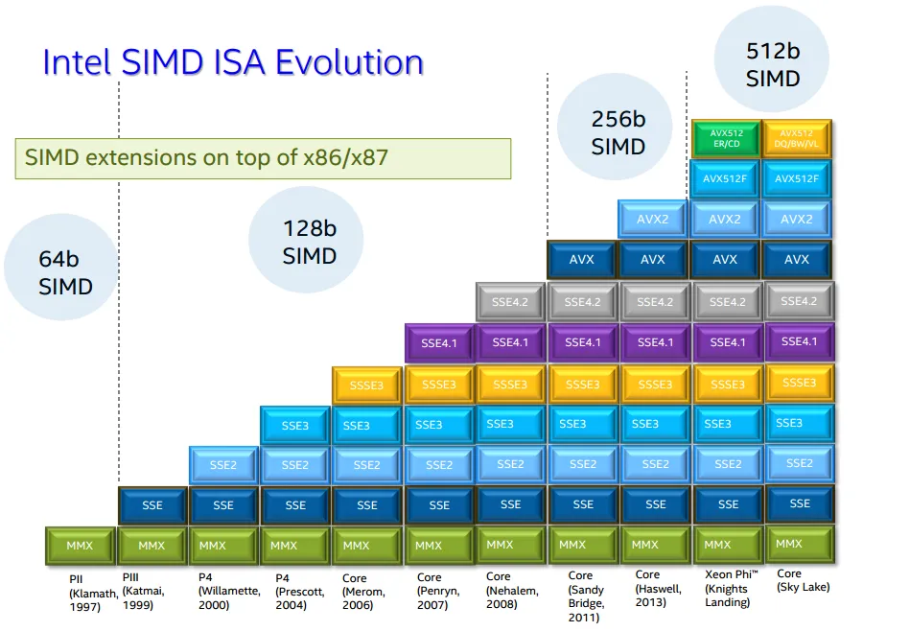
Extended instruction set

Slide 79
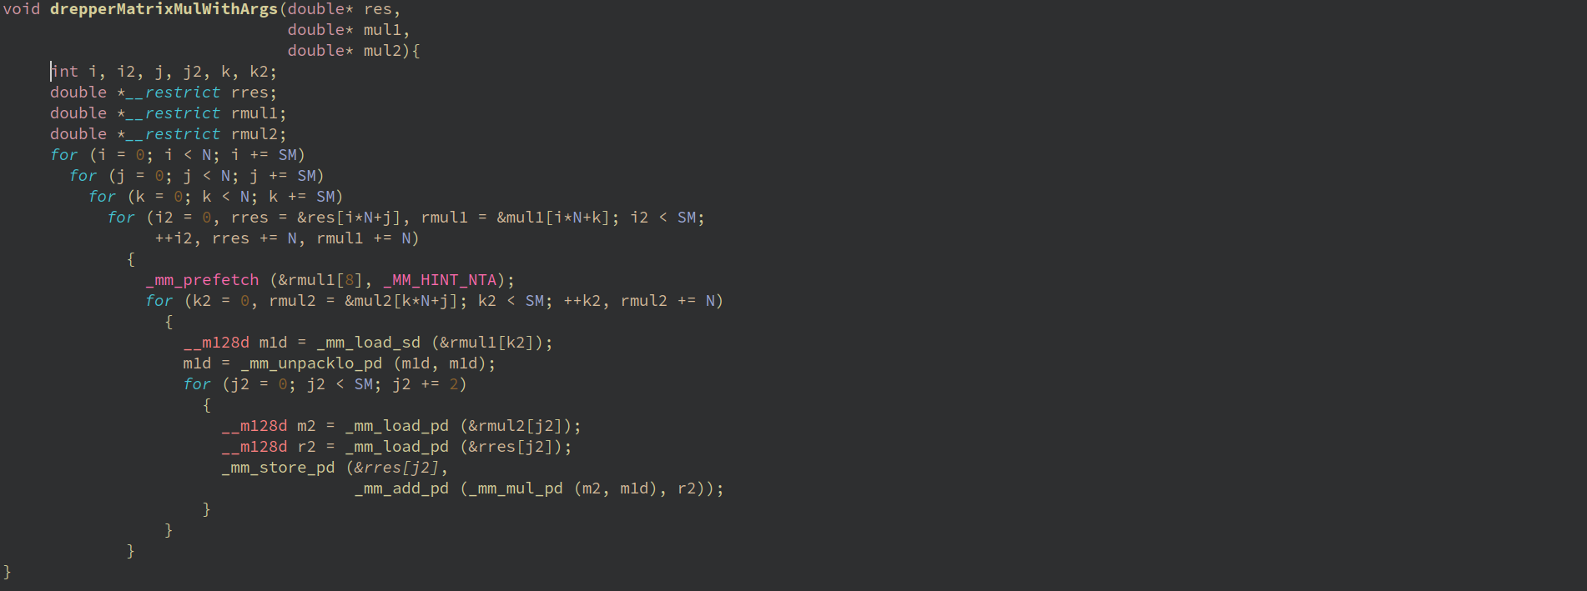

Slide 80
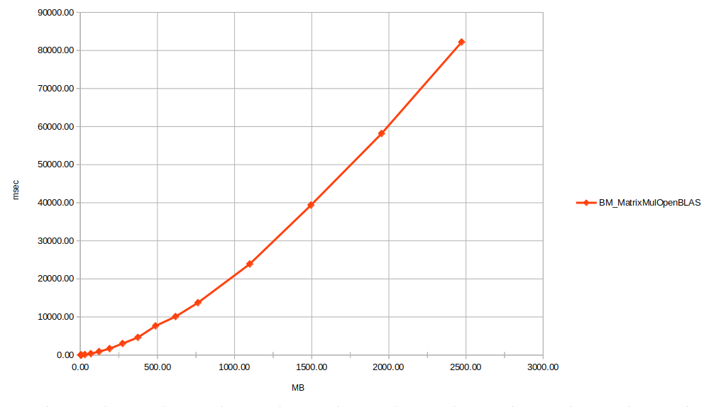
Benchmarks

Slide 81
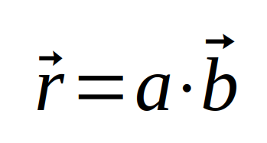
Extended instruction set
r₁₁ = a₁₁*b₁₁ + a₁₂*b₂₁ + a₁₃*b₃₁
r₁₂ = a₁₁*b₁₂ + a₁₂*b₂₂ + a₁₃*b₃₂
r₁₃ = a₁₁*b₁₃ + a₁₂*b₂₃ + a₁₃*b₃₃

Slide 82
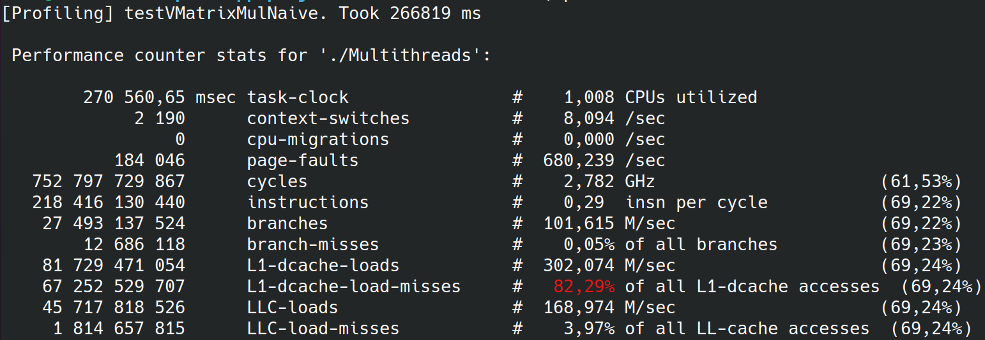
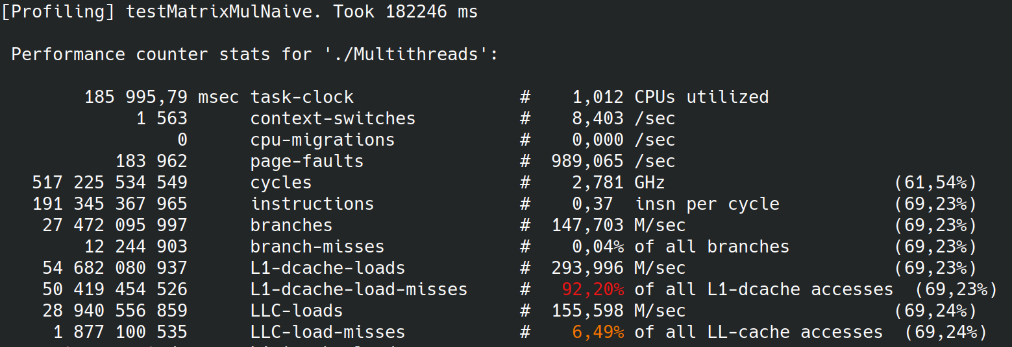
Benchmarks

Slide 83
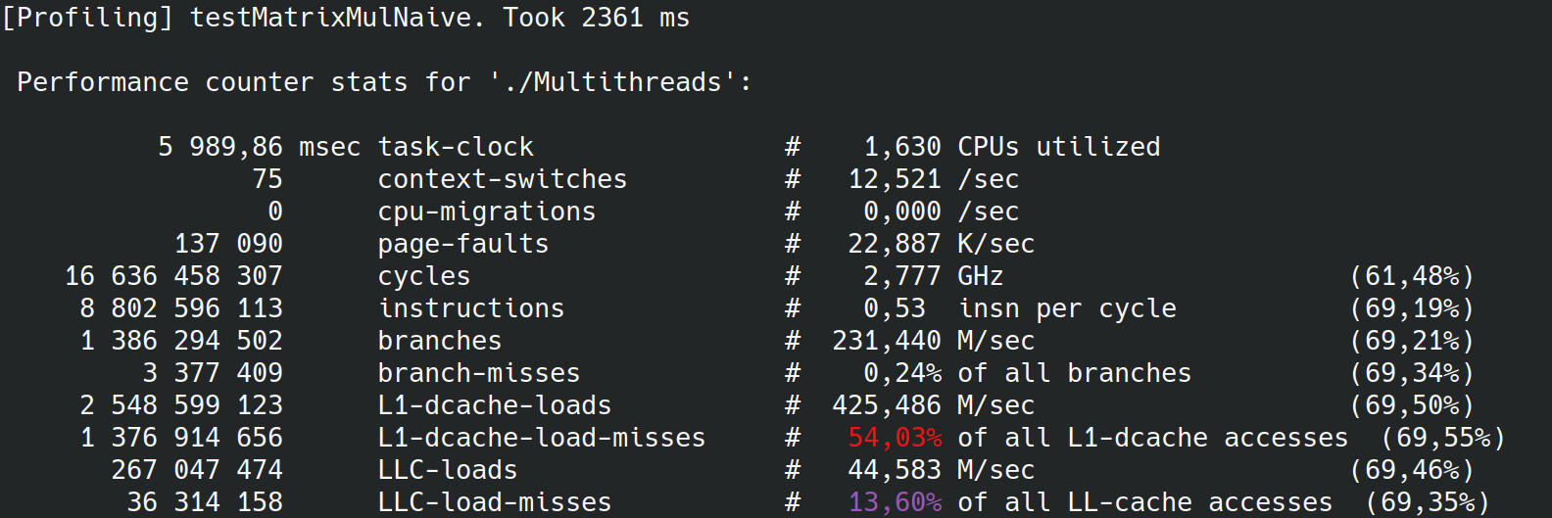

Benchmarks

Slide 84

Aligment
Need better explanation!!!!
a₁₄ | a₁₅ | a₁₆

Slide 85
Block matrix multiplication
x
=
A
B
C

Slide 86
Block matrix multiplication
x
=
A
B^{T}
C

Slide 87



Slide 88

Extended instruction set

Slide 89


Slide 90
Matrix representation

Slide 91
Matrix representation
class Matrix {
std::vector<double> d;
public:
double operator[](std::size_t i, std::size_t j);
};
Matrix m;
m[i,j] = 0

